Slide 1
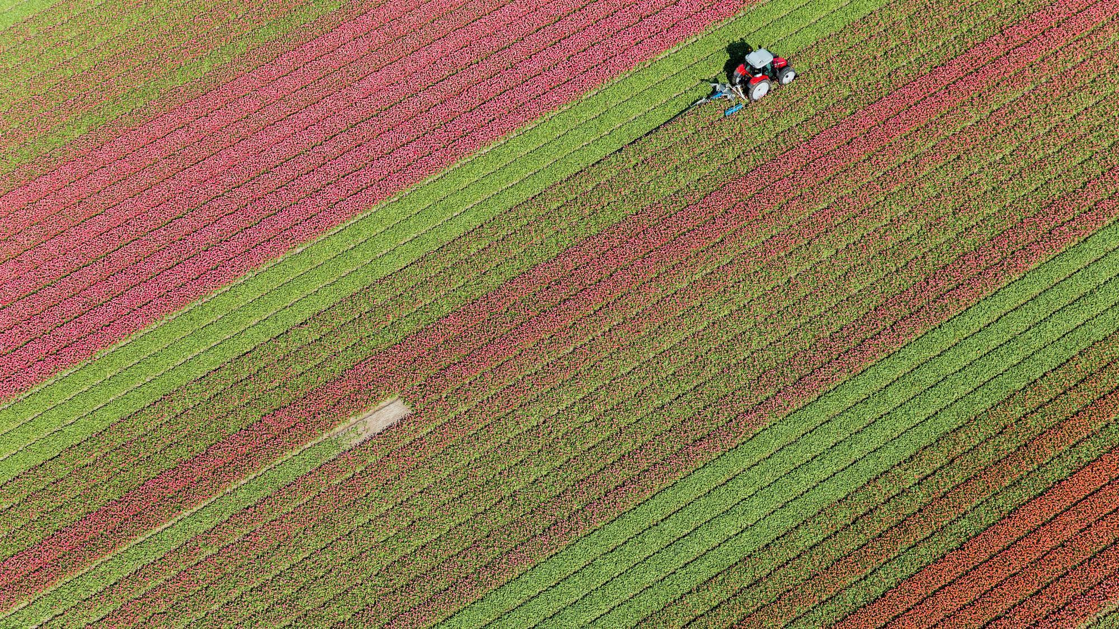
Final Project
Mithun Paulose

Slide 2


Agenda
Introduction
Problem Statement
Data Collection and Preprocessing
EDA
Methodology
Results
Conclusion

Slide 3

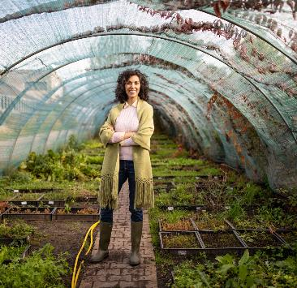

Introduction
Flax seed production in Saskatchewan is progressing with time, somewhat exponentially Analyzing Data for Weyburn( RM -67) in Saskatchewan

Slide 4
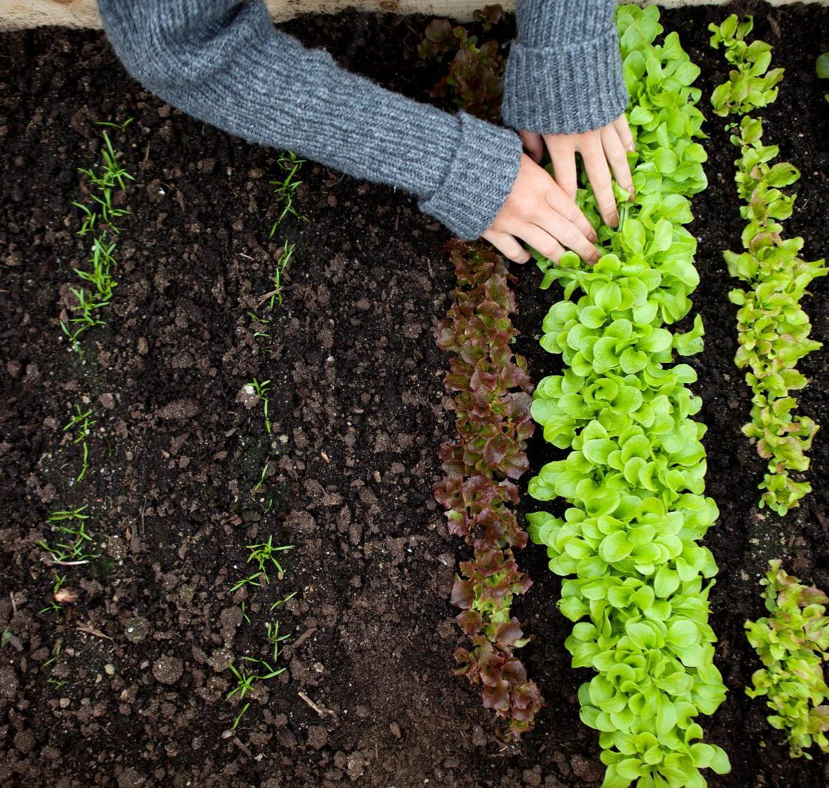
Problem
There are steep drops and steep rises in certain years, and it would be desirable to predict them beforehand

Slide 5

Data Collection and Preprocessing
Source : https://dashboard.saskatchewan.ca/business-economy/business-industry-trade/crop-production
Data about flax seed was clean, and not much effort was needed to fix it. There were 85 non-null values for flax production from 1938 to 2022, bushels per acre being the unit.

Slide 6


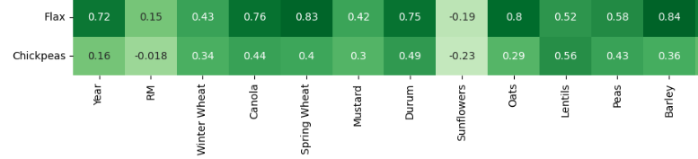
Exploratory Data Analysis
Flax has strong positive correlation with Spring Wheat, Barley

Slide 7
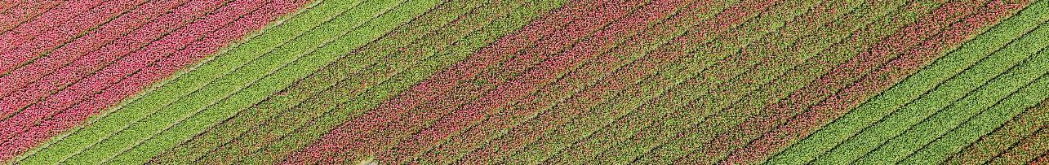
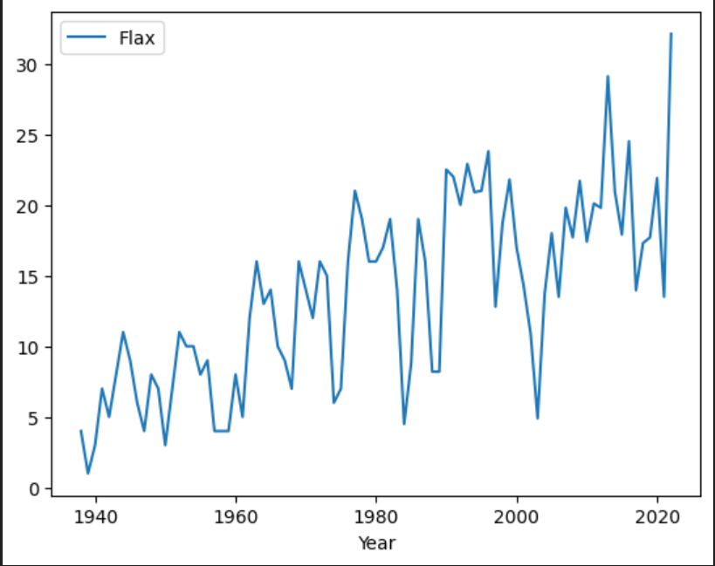
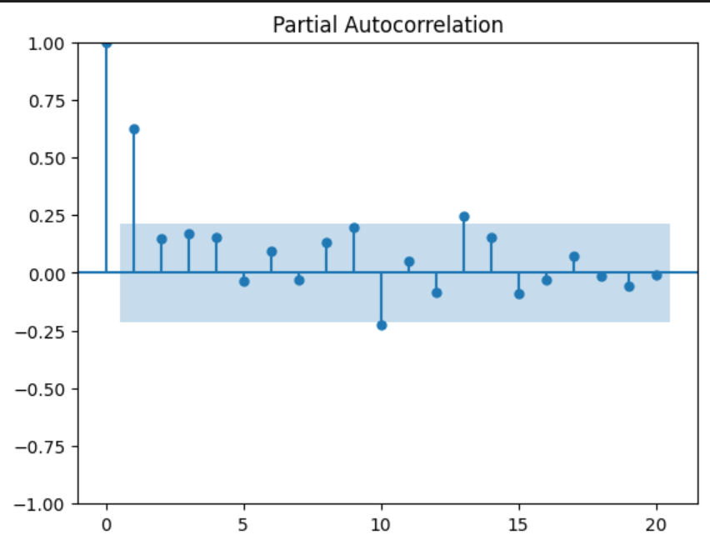

Slide 8
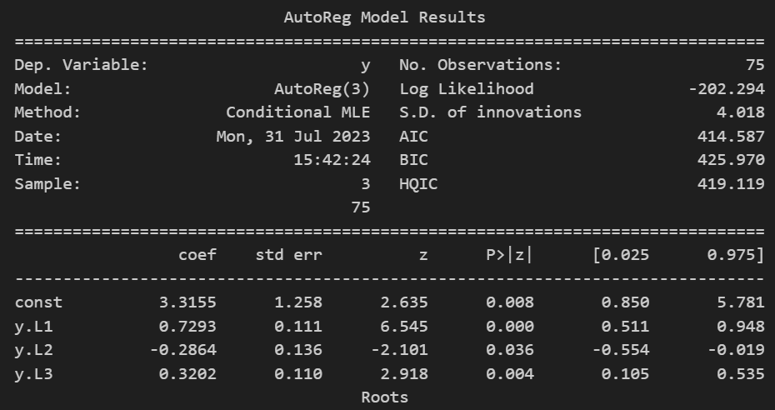

Slide 9
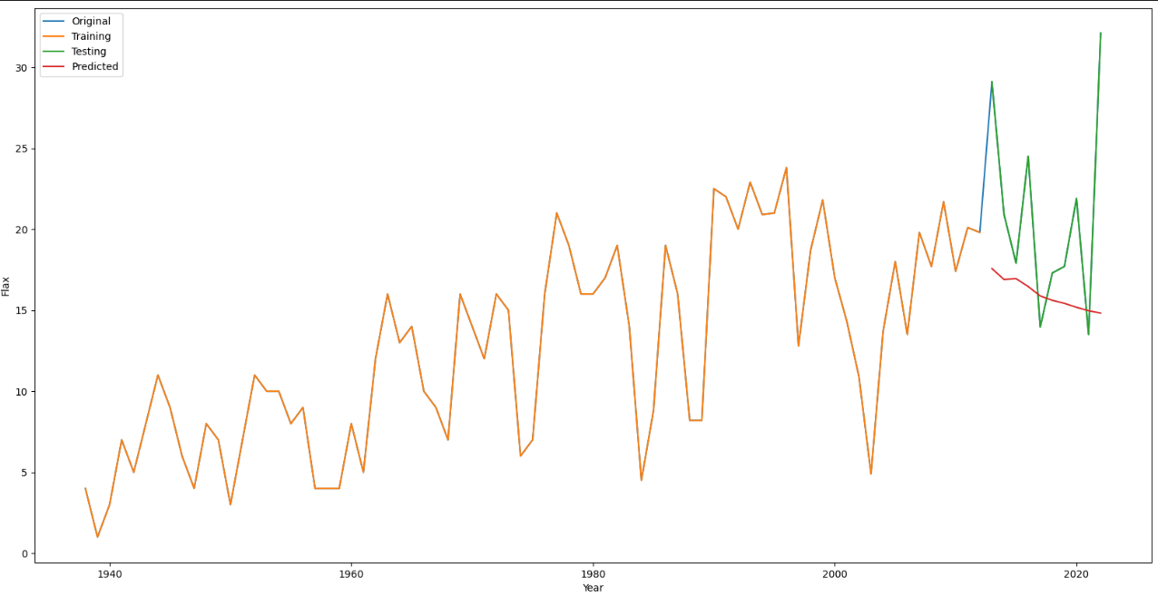
AG Time series
RMSE : 7.564135897223033

Slide 10
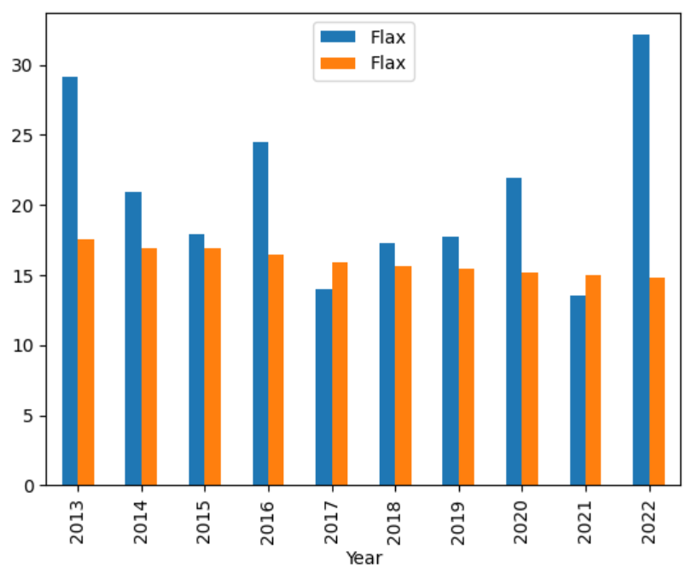

Slide 11
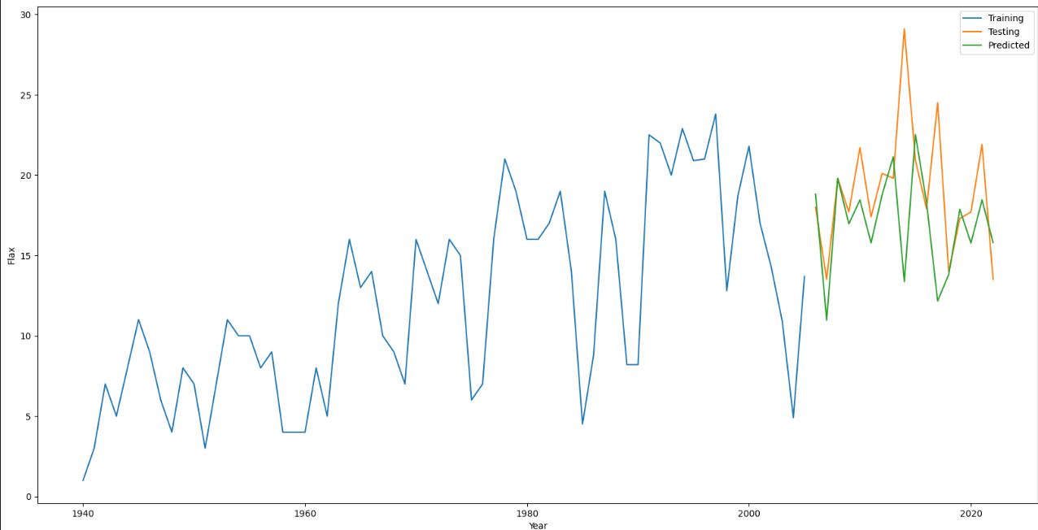
MAE: 5.089997318492217
RMSE: 6.313711331063426
XGBoost Time Series

Slide 12
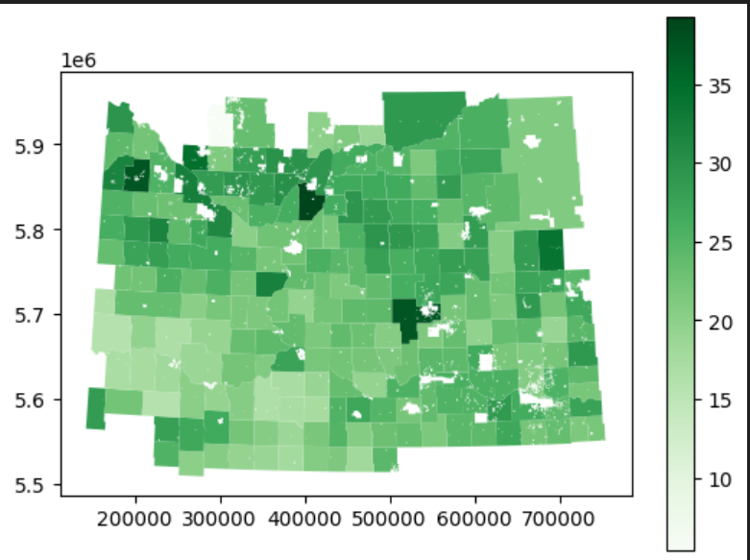
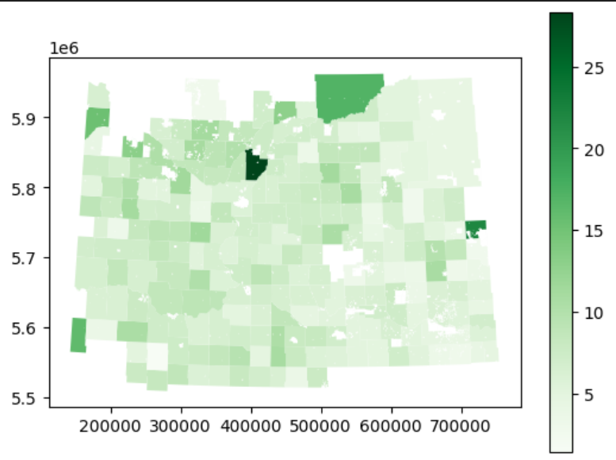
Flax Mean
Flax Std

Slide 13
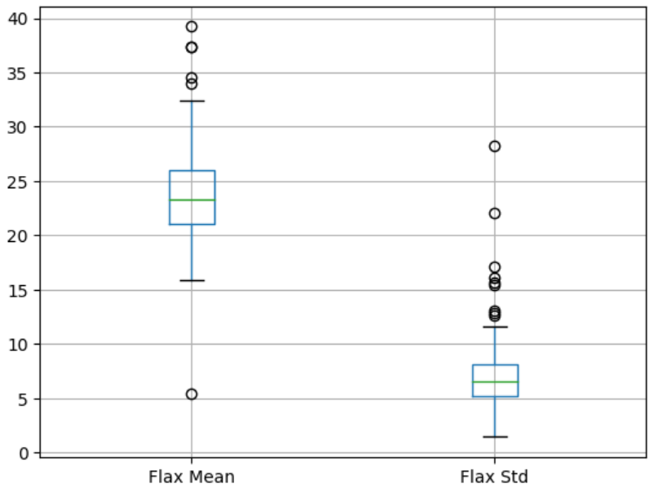
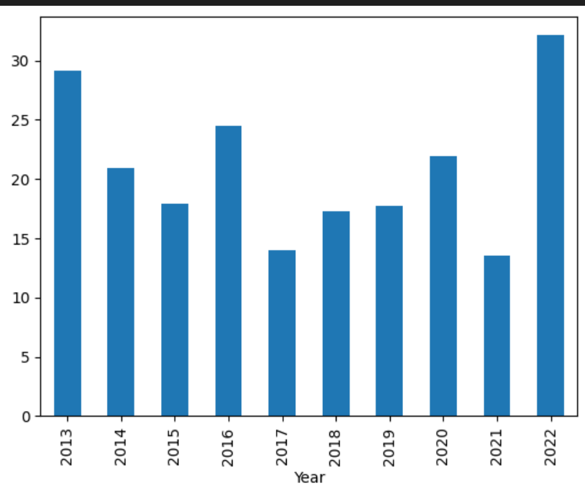
Box Plot
Bar

Slide 14
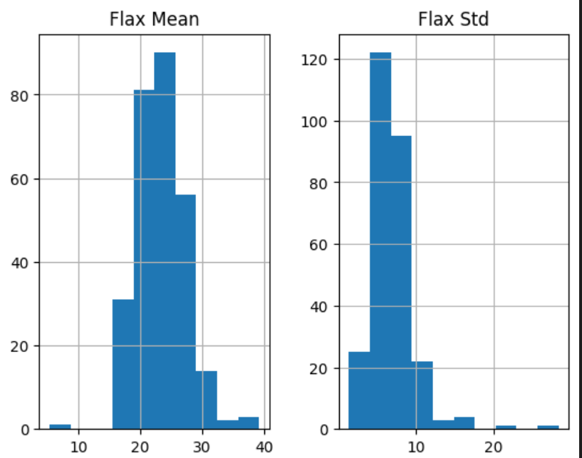
Histogram

Slide 15


Results and Conclusion
Flax seed showed strong correlation to time, making it a strong candidate for future predictions.

Slide 16




Thank You
Mithun Paulose
mithun961@gmail.com

